Slide 1
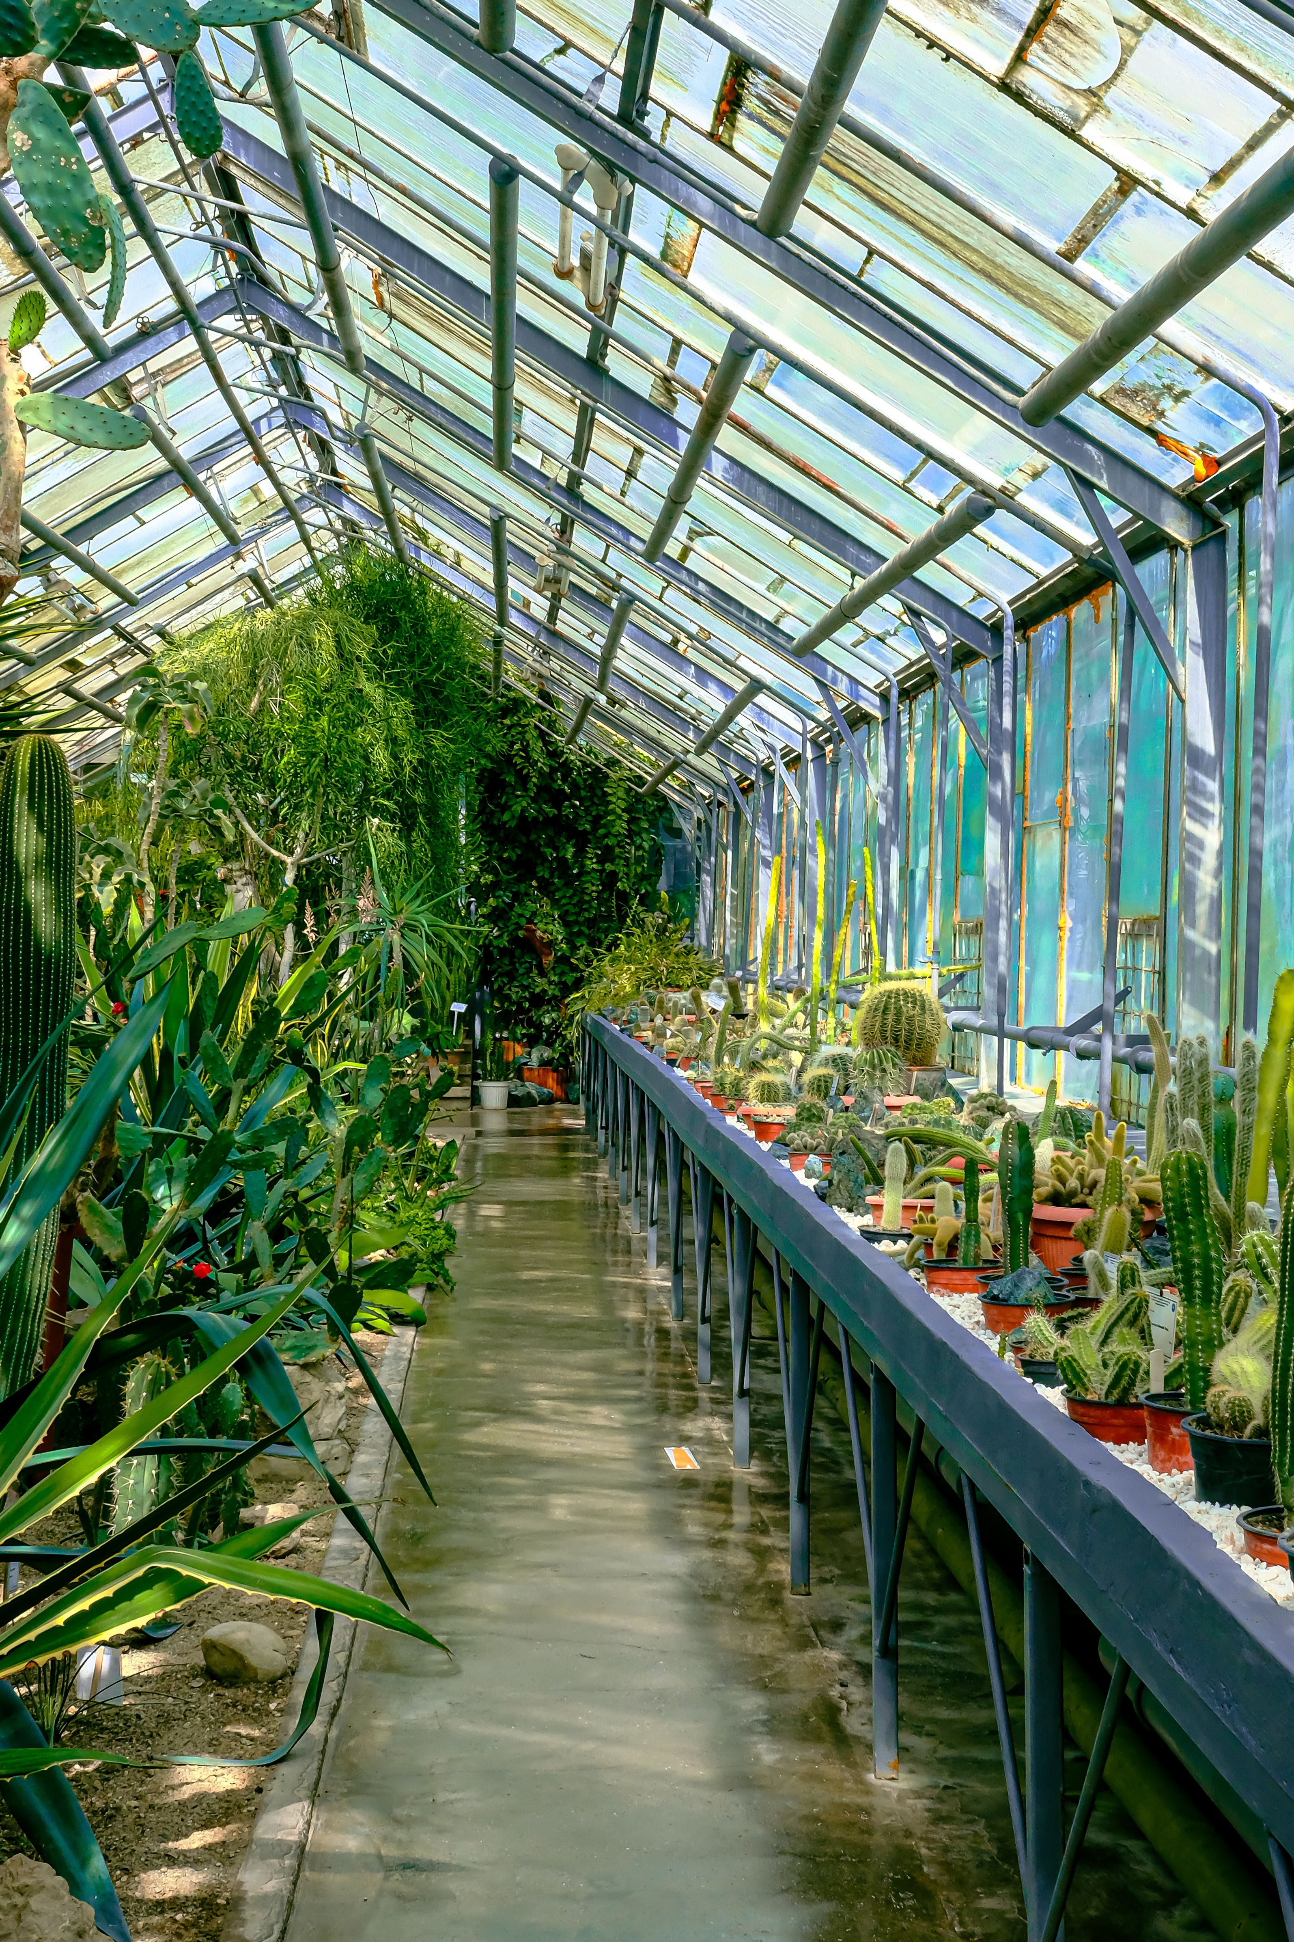

Greenhouse
Monitoring
System
Anurag Sahoo(1928015)
Anwesha Priyadarshani(1928017)
Bibhu Prasanna Dash(1928023)

Slide 2
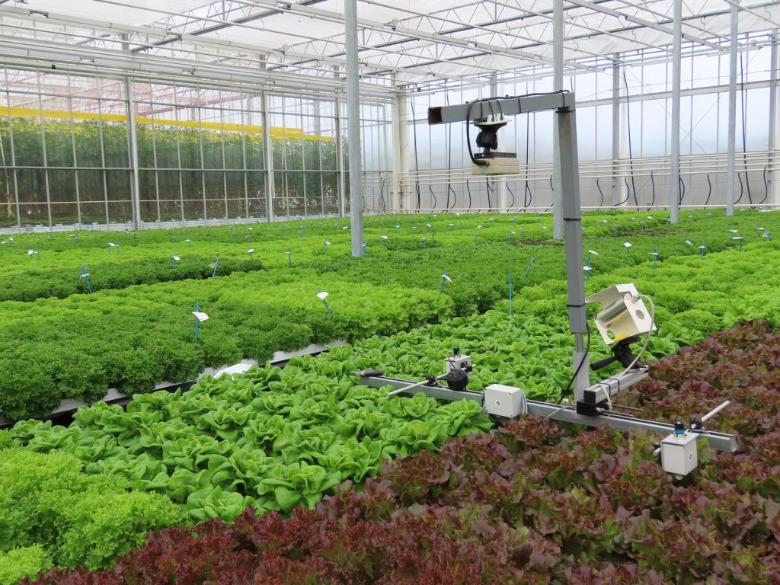

Greenhouse Monitoring System
is a system which is oversee the aspect of a greenhouse, such as temperature, humidity, gases and the light intensity to keep the greenhouse in the ideal condition

Slide 3
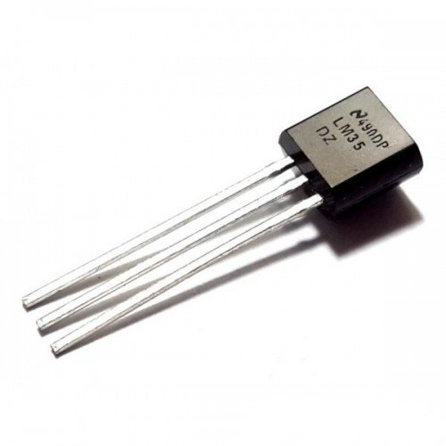
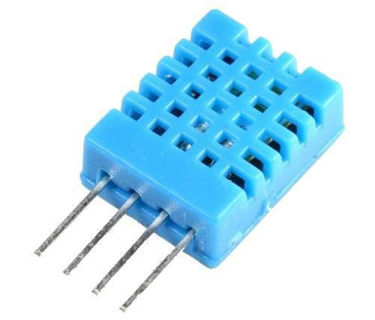
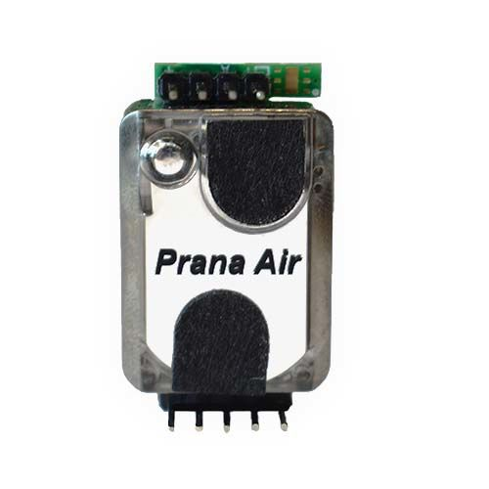
OBJECTIVES OF GREENHOUSE MONITORING SYSTEM
Control the system in greenhouse
using temperature sensor
Control the system in greenhouse using humidity sensor
Control the system in greenhouse using light sensor CO2 sensor

Slide 4
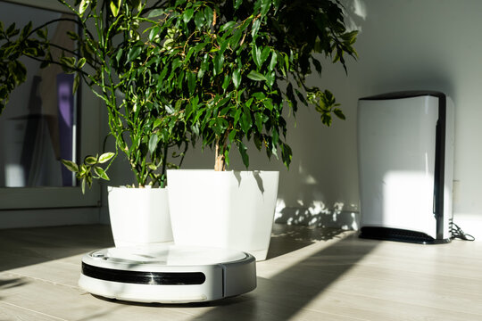

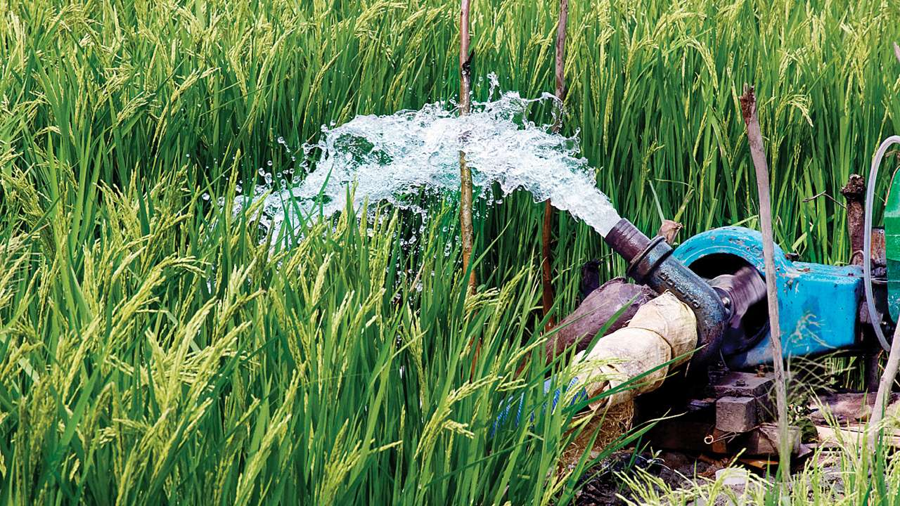


ADVANTAGES
Maintain Ideal Micro-Climate
Prevents thefts and improve security
Enhance irrigation and fertilisation
Controls infection and avoid disease
Improved labour efficiency

Slide 5
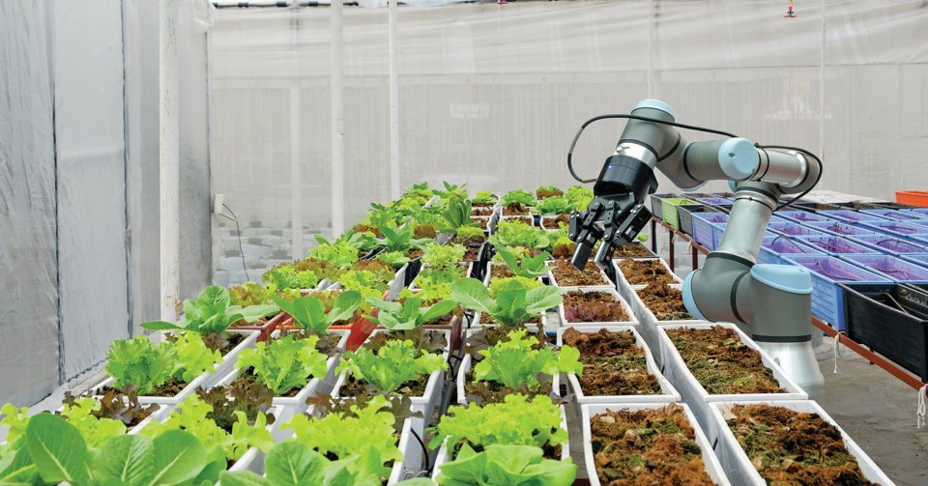

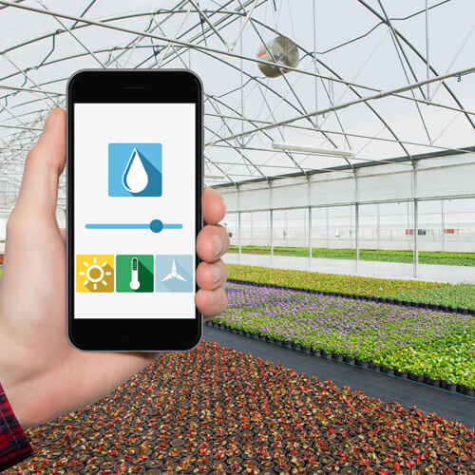
PROBLEM STATEMENT
Greenhouse monitoring using Tinkercad to detect optimal temperature, humidity and light

Slide 6
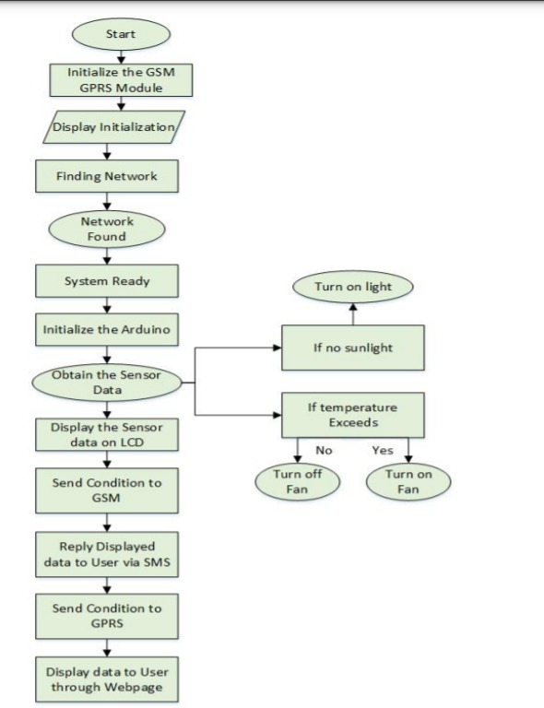
FLOWCHART ON
GREENHOUSE MONITORING SYSTEM TO CONTROL THE TEMPERATURE, LIGHT AND HUMIDITY USING ARDUINO

Slide 7
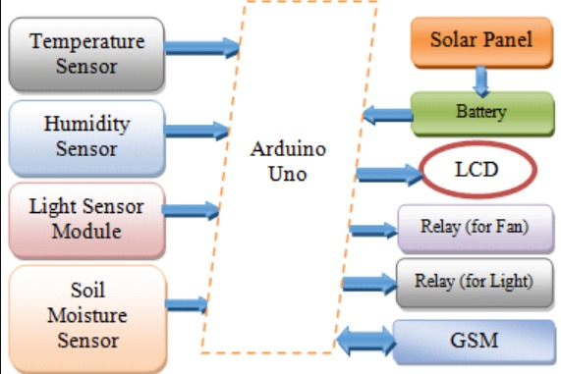
BLOCK DIAGRAM
This block diagram illustrates how the TinkerCad was performed using Arduino UNO using various
components as mentioned in the diagram alongside.

Slide 8
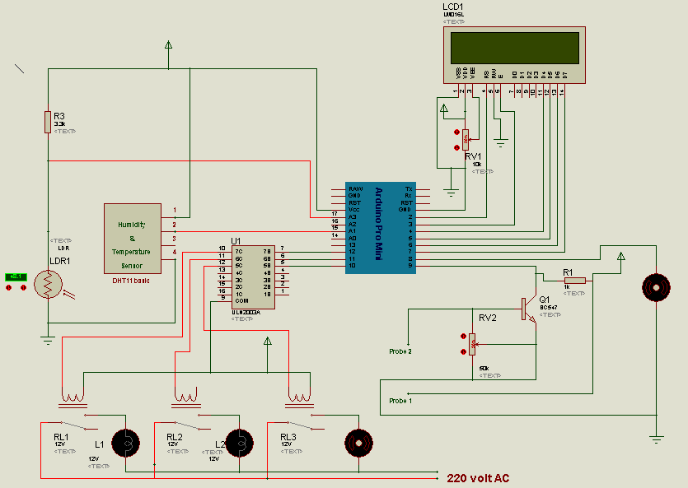
CIRCUIT DIAGRAM
Click here to add the text
In Order To Demonstrate The Good Effect Of The Release
Your text has been concise and beautiful, but the information is inextricably inextricable and needs to be expressed in more words; but please refine the essence of your thought as much as possible, otherwise it is easy to cause the reading pressure of the viewer, which is counterproductive.
Click here to add the text
Click here to add the text
Your text has been concise and beautiful, but the information is inextricably inextricable and needs to be expressed in more words; but please refine the essence of your thought as much as possible, otherwise it is easy to cause

Slide 9
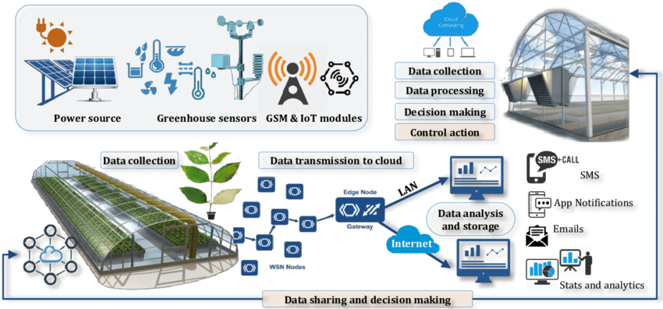
GENERAL COMPONENTS USED IN GREENHOUSE MONITORING SYSTEM

Slide 10
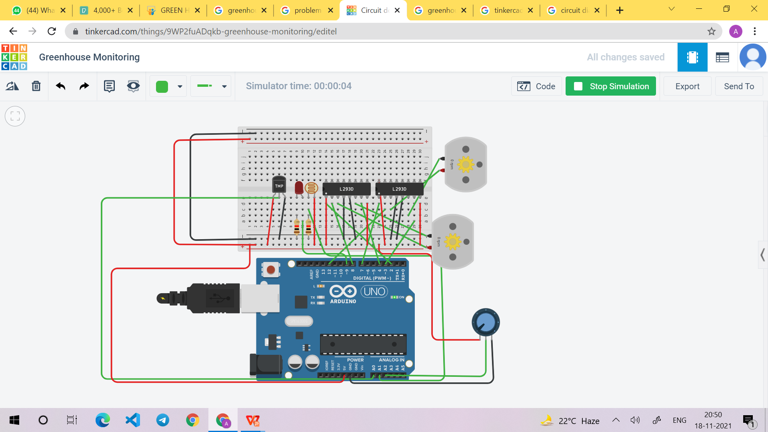
GREENHOUSE MONITORING USING TINKERCAD

Slide 11
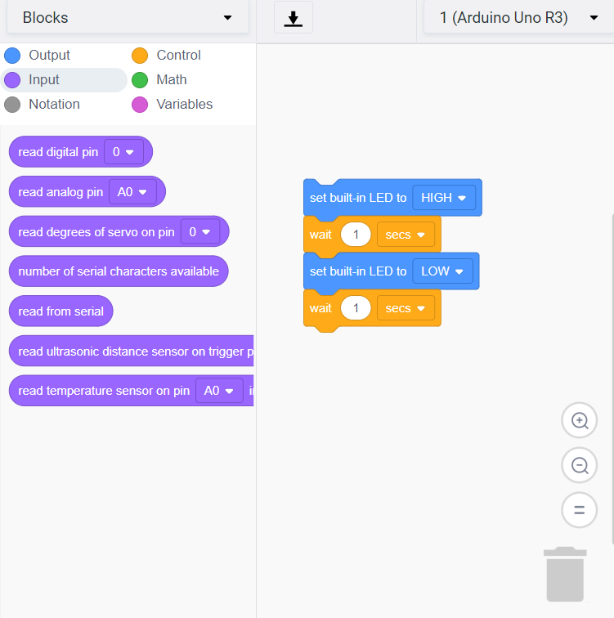
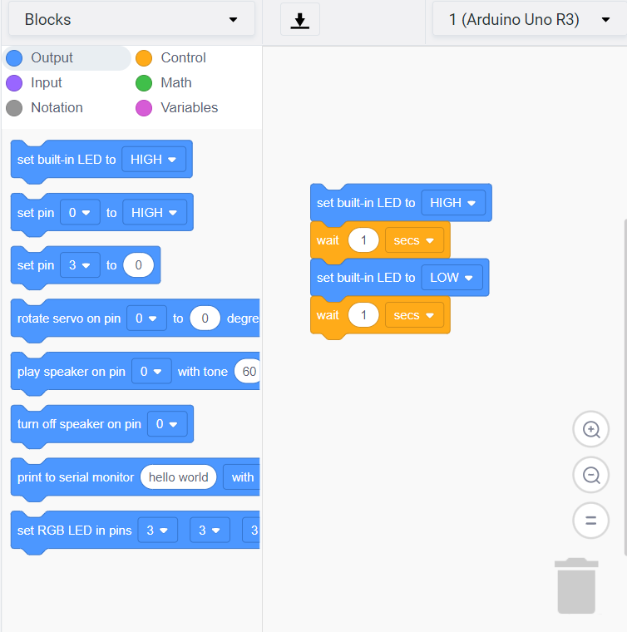
BLOCKS OF TINKERCAD OF GREENHOUSE MONITORING SYSTEM
INPUT
OUTPUT

Slide 12
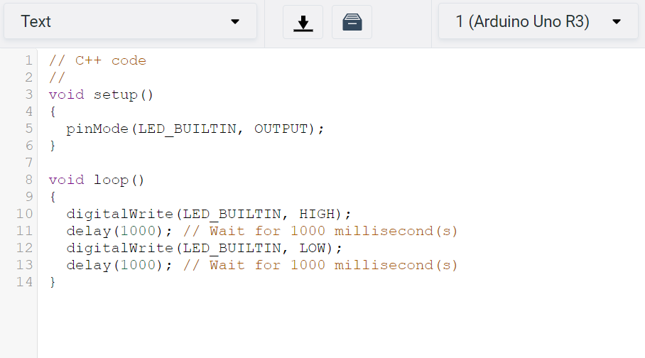

C++ CODE TO DEMONSTRATE THE TINKERCAD
Click here to add the text
Click here to add the text
Your text has been concise
and beautiful, but the information is inextricably inextricable and needs to be expressed in more words
Your text has been concise and beautiful, but the information is inextricably inextricable and needs to be expressed in more words; but please refine the essence of your thought as much as possible, otherwise it is easy to cause

Slide 13
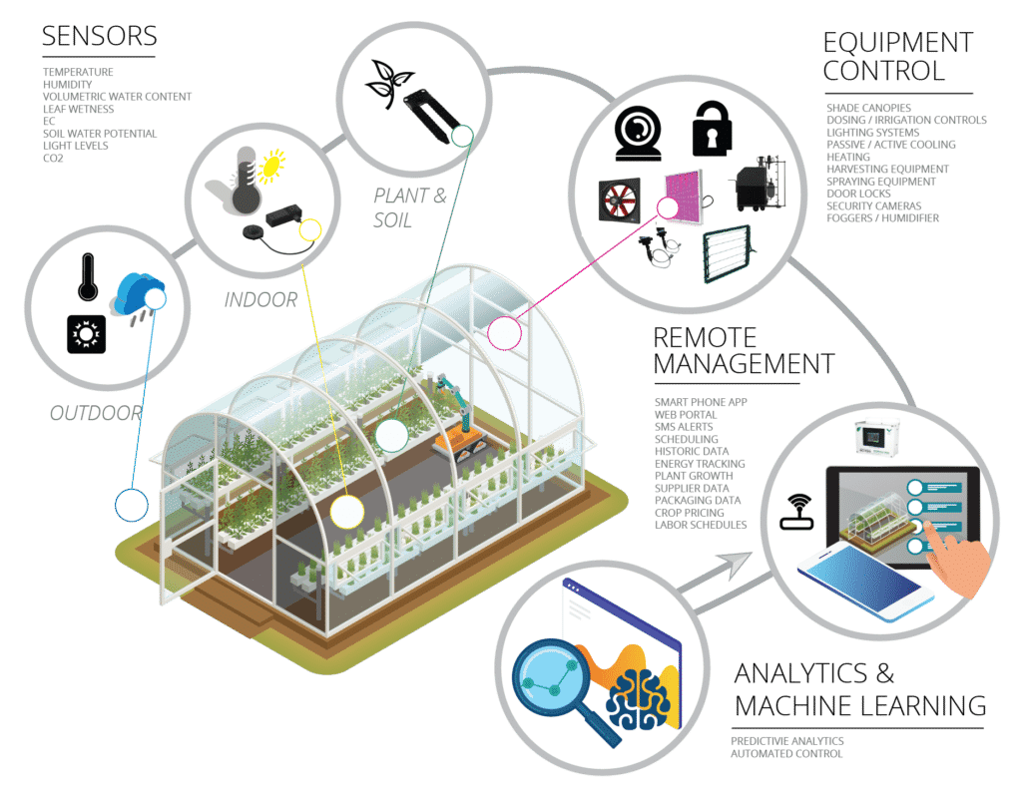
CONTROLLING AND MONITORING ENTIRE OPERATION FROM ANDROID AND iPHONE DEVICE

Slide 14


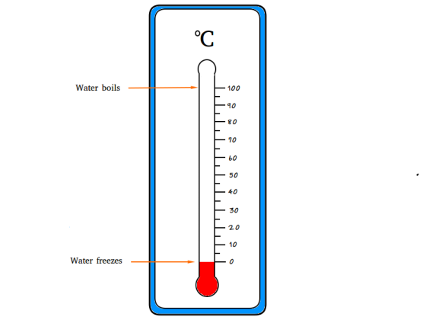
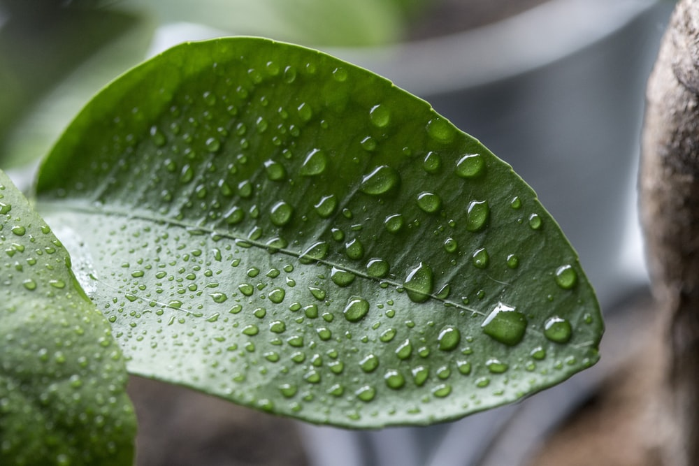



GREENHOUSE STANDARD ASHRAE
TEMPERATURE: 25° C
HUMIDITY: 60-70%
CO2: 300 ppm
LIGHT INTENSITY: 32.000 lux

Slide 15
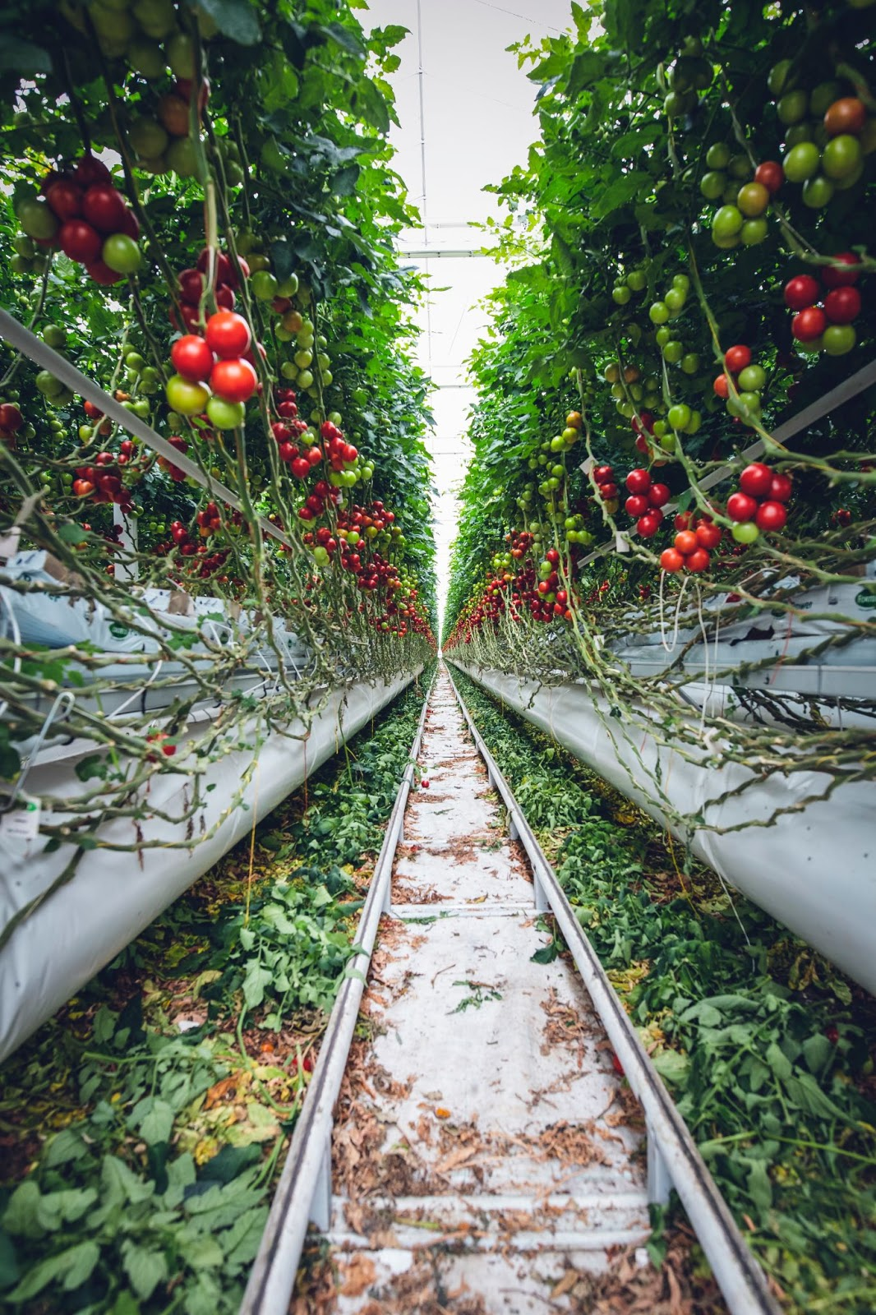
FUTURE SCOPE
This project gives the advancement over the traditional way i.e. monitoring
plant parameters like humidity, temperature, light intensity etc.
But in future not only monitoring plant parameters but we can also monitor the internal health conditioning of the plant through image processing ,it means we can check which part of the plant is having dead cells, and which part of the plant is healthy.
Click here to add the text
In Order To Demonstrate The Good Effect Of The Release
Your text has been concise and beautiful, but the information is inextricably inextricable and needs to be expressed in more words; but please refine the essence of your thought as much as possible, otherwise it is easy to cause the reading pressure of the viewer, which is counterproductive.

Slide 16
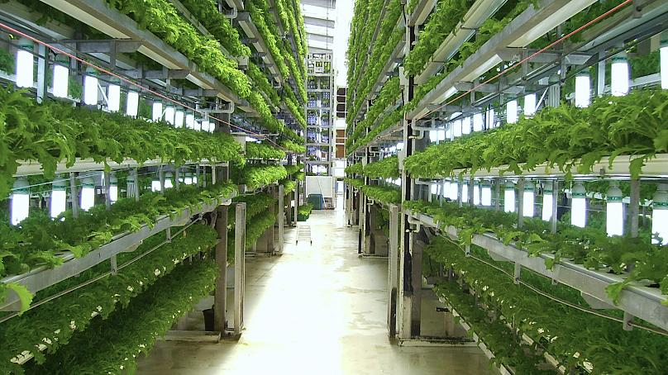
CONCLUSION
We build an automated greenhouse model using Arduino technology.
The system superviand control factors such as light, temperature etc by saving time and money.
The system is modified to alert farmers regarding the parameters changes in the greenhouse so that early precaution steps can be taken.

Slide 17
REFERENCES
1. Guohong Li, Wenjing Zhang, Yi Zhang ,A Design of the IOT Gateway for Agricultural greenhouse Sensors & Transducers , Vol. 172 , Issue 6 , June 2014 , pp.75-80
2. https://ieeexplore.ieee.org/document/8662911
3. Internet of Things by Arshdeep Bagha and Vijay Madisetti
4. Wikipedia(Images and content)

Slide 18

THANK YOU
Our full project available at: https://github.com/anweshapriyadarshani/Greenhouse-monitoring

